Slide 1
Arduino aansturen via javascript
Web Research
Lander Verschueren

Slide 2

Johhny five
The JavaScript Arduino IoT Platform

Slide 3

Node.JS

Slide 4

Socket.io
Socket.IO enables real-time bidirectional event-based communication

Slide 5
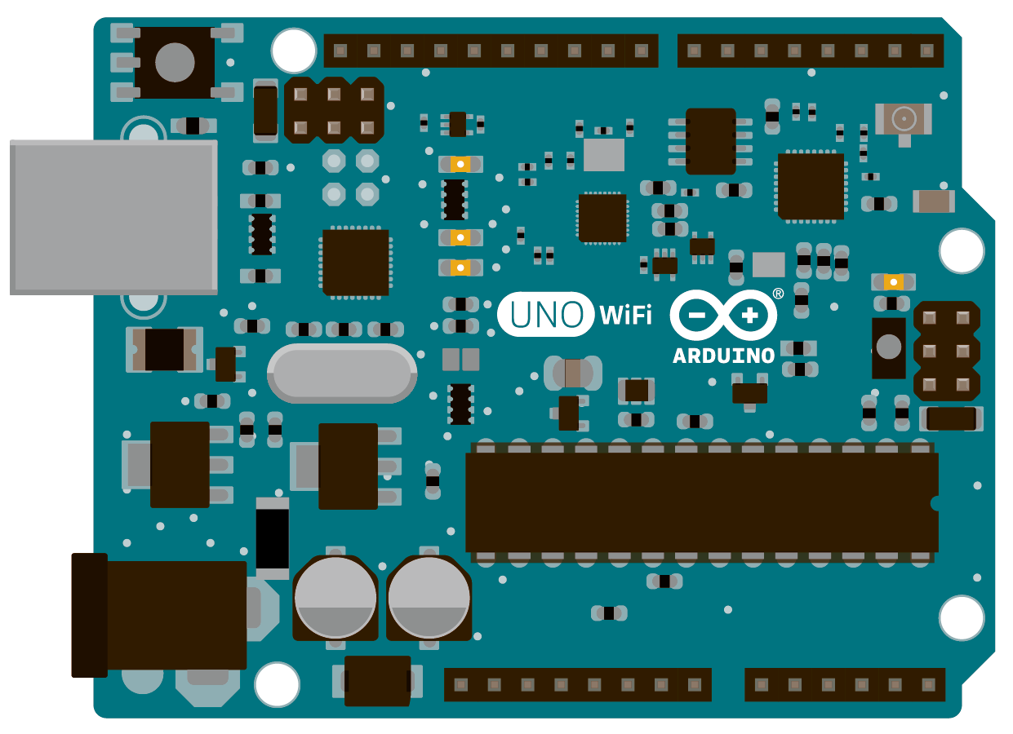
Arduino

